Slide 1

Feature Extraction Techniques
Mansoor Nasir

Slide 2
Techniques
Bag of Words
TF-IDF
RAKE: Rapid Automatic Keyword Extraction
Word2Vec

Slide 3
Introduction
The bag-of-words model is a way of representing text data when modeling text with machine learning algorithms.
The bag-of-words model is simple to understand and implement and has seen great success in problems such as language modeling and document classification.
It is used for feature extraction in text data

Slide 4
Problem with text data
A problem with modeling text is that it is messy, and techniques like machine learning algorithms prefer well defined fixed-length inputs and outputs.
Machine learning algorithms cannot work with raw text directly; the text must be converted into numbers. Specifically, vectors of numbers.
This is called feature extraction or feature encoding.
A popular and simple method of feature extraction with text data is called the bag-of-words model of text.

Slide 5
What is a Bag-of-Words?
A bag-of-words model, or BoW for short, is a way of extracting features from text for use in modeling, such as with machine learning algorithms.
A bag-of-words is a representation of text that describes the occurrence of words within a document. It involves two things:
A vocabulary of known words.
A measure of the presence of known words.
It is called a “bag” of words, because any information about the order or structure of words in the document is discarded. The model is only concerned with whether known words occur in the document, not where in the document.

Slide 6
Step 1: Data Collection
It was the best of times,
it was the worst of times,
it was the age of wisdom,
it was the age of foolishness,
For this small example, let’s treat each line as a separate “document” and the 4 lines as our entire corpus of documents.
Text from the book “A Tale of Two Cities” by Charles Dickens

Slide 7
Step 2: Design the Vocabulary
Now we can make a list of all of the words in our model vocabulary.
The unique words here (ignoring case and punctuation) are:
“it”
“was”
“the”
“best”
“of”
“times”
“worst”
“age”
“wisdom”
“foolishness”
That is a vocabulary of 10 words from a corpus containing 24 words.

Slide 8
Step 3: Create Document Vectors
The next step is to score the words in each document.
The objective is to turn each document of free text into a vector that we can use as input or output for a machine learning model.
Because we know the vocabulary has 10 words, we can use a fixed-length document representation of 10, with one position in the vector to score each word.
The simplest scoring method is to mark the presence of words as a boolean value, 0 for absent, 1 for present.
Using the arbitrary ordering of words listed above in our vocabulary, we can step through the first document (“It was the best of times“) and convert it into a binary vector.

Slide 9
Step 3: Create Document Vectors
The scoring of the document would look as follows:
“it” = 1
“was” = 1
“the” = 1
“best” = 1
“of” = 1
“times” = 1
“worst” = 0
“age” = 0
“wisdom” = 0
“foolishness” = 0

Slide 10
Step 3: Create Document Vectors
As a binary vector, this would look as follows:
[1, 1, 1, 1, 1, 1, 0, 0, 0, 0]
"it was the worst of times" = [1, 1, 1, 0, 1, 1, 1, 0, 0, 0]
"it was the age of wisdom" = [1, 1, 1, 0, 1, 0, 0, 1, 1, 0]
"it was the age of foolishness" = [1, 1, 1, 0, 1, 0, 0, 1, 0, 1]
New words can be encoded such that where only the occurrence of known words are scored and unknown words are ignored.
You can see how this might naturally scale to large vocabularies and larger documents.

Slide 11
Managing Vocabulary
Managing large vocabulary is a problem in BoW
You can imagine that for a very large corpus, such as thousands of books, that the length of the vector might be thousands or millions of positions.
Further, each document may contain very few of the known words in the vocabulary.
This results in a vector with lots of zero scores, called a sparse vector or sparse representation.
As such, there is pressure to decrease the size of the vocabulary when using a bag-of-words model.

Slide 12
Managing Vocabulary
There are simple text cleaning techniques that can be used as a first step, such as:
Ignoring case
Ignoring punctuation
Ignoring frequent words that don’t contain much information, called stop words, like “a,” “of,” etc.
Fixing misspelled words.
Reducing words to their stem (e.g. “play” from “playing”) using stemming algorithms.
A more sophisticated approach is to create a vocabulary of grouped words.
In this approach, each word or token is called a “gram”. Creating a vocabulary of two-word pairs is, in turn, called a bigram model.

Slide 13
Managing Vocabulary
For example, the bigrams in the first line of text in the previous section: “It was the best of times” are as follows:
“it was”
“was the”
“the best”
“best of”
“of times”
A vocabulary then tracks triplets of words is called a trigram model and the general approach is called the n-gram model, where n refers to the number of grouped words.
Often a simple bigram approach is better than a 1-gram bag-of-words model for tasks like documentation classification.

Slide 14
Scoring Words
Once a vocabulary has been chosen, the occurrence of words in example documents needs to be scored.
In the worked example, we have already seen one very simple approach to scoring: a binary scoring of the presence or absence of words.
Some additional simple scoring methods include:
Counts. Count the number of times each word appears in a document.
Frequencies. Calculate the frequency that each word appears in a document out of all the words in the document.
We can use a hash representation of known words in our vocabulary. This is called the “hash trick” or “feature hashing“.

Slide 15
TF-IDF
A problem with scoring word frequency is that highly frequent words start to dominate in the document (e.g. larger score), but may not contain as much “informational content” to the model as rarer but perhaps domain specific words.
One approach is to rescale the frequency of words by how often they appear in all documents, so that the scores for frequent words like “the” that are also frequent across all documents are penalized.
This approach to scoring is called Term Frequency – Inverse Document Frequency, or TF-IDF for short, where:
Term Frequency: is a scoring of the frequency of the word in the current document.
Inverse Document Frequency: is a scoring of how rare the word is across documents.
The scores are a weighting where not all words are equally as important or interesting.
The scores have the effect of highlighting words that are distinct (contain useful information) in a given document.

Slide 16
Limitations of Bag-of-Words
Vocabulary: The vocabulary requires careful design, most specifically in order to manage the size, which impacts the sparsity of the document representations.
Sparsity: Sparse representations are harder to model both for computational reasons (space and time complexity) and also for information reasons, where the challenge is for the models to harness so little information in such a large representational space.
Meaning: Discarding word order ignores the context, and in turn meaning of words in the document (semantics). Context and meaning can offer a lot to the model, that if modeled could tell the difference between the same words differently arranged (“this is interesting” vs “is this interesting”), synonyms (“old bike” vs “used bike”), and much more.

Slide 17
TF-IDF
Term frequency-inverse document frequency (TF-IDF) measures the importance of a word to a specific document.
It’s the product of two statistics: term frequency (TF) and inverse document frequency (IDF).

Slide 18
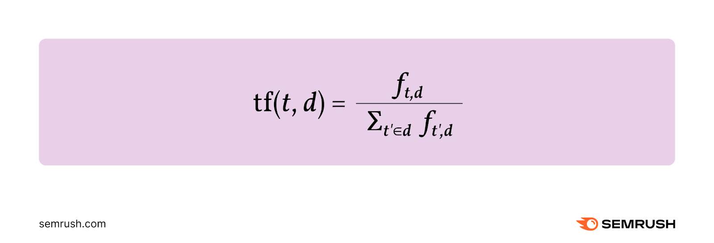
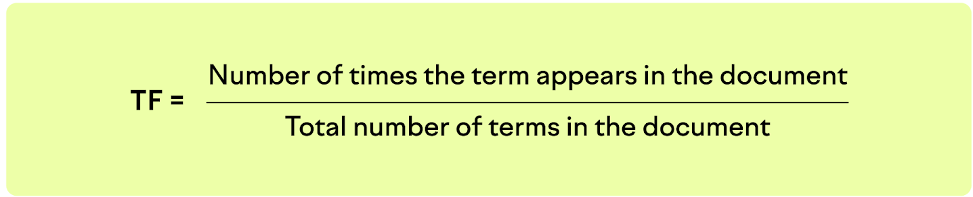
Term Frequency (TF)
Term frequency (TF) can be defined as the relative frequency of a term (t) within a document (d).
It’s calculated by dividing the number of times the term occurs in the document (ft,d) by the total number of terms in the document.
Here’s the formula:

Slide 19
Term Frequency (TF)
For example, say you have a document containing 10,000 terms. And a specific term appears a total of 25 times in the document.
You’d calculate the term frequency as follows:
TF = 25/10,000 = 0.0025

Slide 20
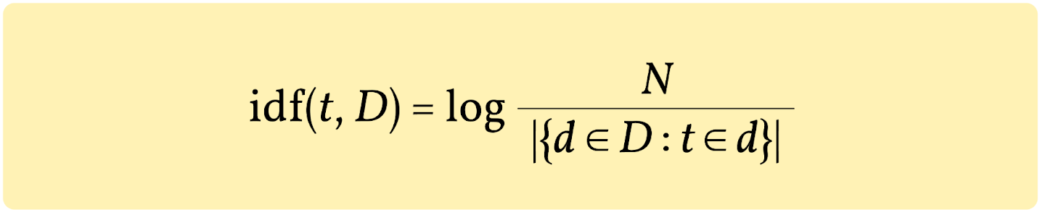
Inverse Document Frequency (IDF)
Inverse document frequency (IDF) measures the amount of information a term provides.
It’s calculated by dividing the total number of documents (N) by the number of documents that contain the term. Then, taking the logarithm of that quotient.
Here’s the formula:

Slide 21
IDF
Let's say you have a collection of 10,000 documents (N=10,000), and a term appears in 500 of these documents.
Here’s how you’d calculate the IDF:
IDF = log 10,000/500 = 1.30

Slide 22
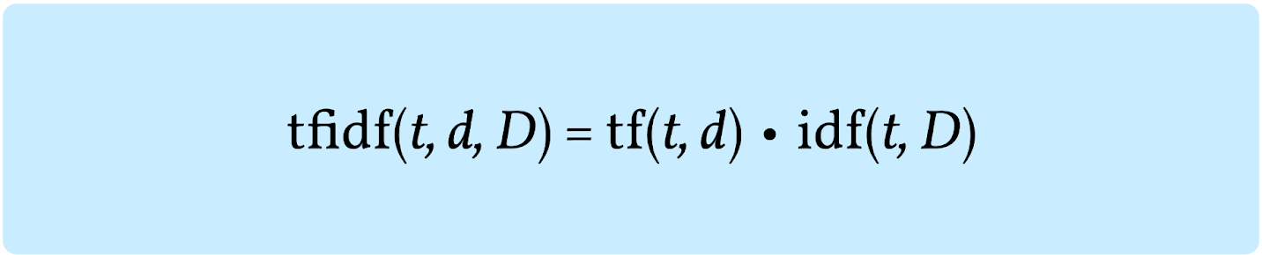
TF-IDF
To calculate TF-IDF, we need to multiply the values of TF and IDF:
TF-IDF = 0.00325
The final score shows the relevance of the term, with a higher score denoting higher relevance and a lower score denoting lower relevance.

Slide 23
Example
Simply examining the TF, IDF, and TF-IDF formulas can be a bit overwhelming. Let’s take a look at an actual example.
Let’s say that the term “car” appears 25 times in a document that contains 1,000 words.
We’d calculate the term frequency (TF) as follows:
TF = 25/1,000 = 0.025
Next, let’s say that a collection of related documents contains a total of 15,000 documents.
If 300 documents out of the 15,000 contain the term “car,” we would calculate the inverse document frequency as follows:
IDF = log 15,000/300 = 1.69
Now, we can calculate the TF-IDF score by multiplying these two numbers:
TF-IDF = TF x IDF = 0.025 x 1.69 = 0.04225

Slide 24
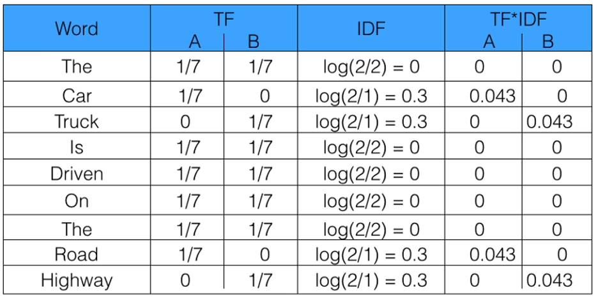
Example
A = “The car is driven on the road”; B = “The truck is driven on the highway”

Slide 25
Benefits
Easy to calculate: Perhaps the biggest benefit of using TF-IDF is that it’s fairly simple to calculate and can serve as a starting point for more advanced analysis
Identifies important terms: It can help identify important terms in a document, which is very useful for understanding what a document is about
Differentiates between common and rare terms: Since TF-IDF looks at both the number of occurrences of a term in a single document—as well as the number of occurrences of the same term in a collection of documents—it helps to differentiate between common and rare terms
Language-independent: TF-IDF works across all languages and is not limited by the language of a document
Scalable: It’s capable of handling very big datasets containing a large number of documents

Slide 26
Limitations
Very rare terms can be problematic: IDF scores can be misleadingly high for very rare terms, making them seem more important than they really are
No understanding of meaning or context: TF-IDF only measures term frequency—it doesn’t understand the meaning behind the terms or the context in which they’re used
Ignores word order: TF-IDF doesn’t care about word order so it can’t comprehend compound nouns or phrases as single-unit terms
Difficulties interpreting synonyms and similar words: Since TF-IDF treats each term independently, it can have difficulties recognizing synonyms and similar words, which can lead to misleading scores

